Slide 1
Temperature Prediction with Python and Machine Learning FOR Dhaka City Corporation.
Submitted By: Kollan Halder Student of the Department of Coastal Studies and Disaster Management Class Roll:17Cdm007 University of Barishal | Submitted To: Dr. Tania Islam Assistant Professor Department of Computer Science and Engineering, University of Barishal

Slide 2
Introduction
This study focuses on using machine learning to predict urban temperature in Dhaka City Corporation (DCC), addressing challenges due to rapid urbanization and climate change. Traditional models struggle with complex urban dynamics, but machine learning offers flexibility by incorporating diverse meteorological and environmental data.

Slide 3
Introduction
Techniques like LSTMs and ensemble methods aim to provide precise, short- and medium-term forecasts, aiding urban resilience and public health. The research highlights machine learning's potential to enhance urban planning and sustainable development, helping mitigate heat effects and adapt to future climate challenges.

Slide 4
Objective of the Study
Data Collection and Preprocessing
Model Development
Performance Evaluation
Analysis of Influencing Factors
Implementation of Predictive Insights

Slide 5
Rationality of the Study
Urban Heat Island Effect
Urban Heat Island Effect
Data-Driven Decision Making
Local Relevance
Technological Advancements

Slide 6
Significance of the Study
Urban Climate Management
Disaster Preparedness and Response
Informing Infrastructure Development
Supporting Sustainable Development Goals (SDGs)
Contribution to Academic Knowledge
Empowering Community Resilience

Slide 7
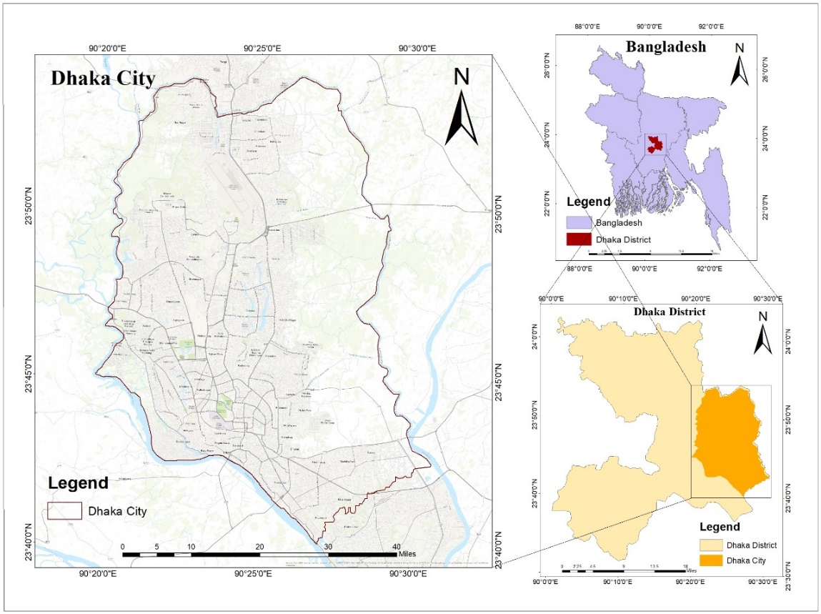
MATERIALS & METHODS
Study Area Description
The study area for this research is Dhaka City Corporation (DCC), the capital and largest city of Bangladesh, known for its rapid urbanization and dense population. Covering approximately 306 square kilometers, Dhaka is situated on the banks of the Buriganga River and serves as the political, economic, and cultural heart of the country.

Slide 8
MATERIALS & METHODS
Ridge Regression for Temperature Prediction
This study employs Ridge Regression to predict daily average temperatures, addressing overfitting and multicollinearity in weather data by introducing a penalty term that stabilizes predictions. The model’s regularization strength, controlled by the hyperparameter alpha, helps balance fit and performance. Ridge Regression is effective for temperature prediction due to interdependencies among weather features, providing stable results. Performance is evaluated through backtesting with metrics like Mean Absolute Error (MAE

Slide 9
MATERIALS & METHODS
Downloading the data
This section describes the data source and the process of downloading the weather data. In your code, the data is loaded from a CSV file using the pd.read_csv() function. Specify the source of your data (e.g., NOAA website, a specific weather station) and any relevant information about data acquisition.

Slide 10
MATERIALS & METHODS
Loading in the data
The date column is converted to a datetime index for time series analysis:
import pandas as pd
weather = pd.read_csv("/content/weather.csv", index_col="DATE")
weather.index = pd.to_datetime(weather.index)

Slide 11
MATERIALS & METHODS
Cleaning missing values
Missing values in the 'tavg' column are filled with the mean, and forward fill is applied to handle remaining missing data:
weather['tavg'] = weather['tavg'].fillna(weather['tavg'].mean())
weather = weather.ffill()

Slide 12
MATERIALS & METHODS
Prepping data for machine learning
Relevant features are selected, and a target variable ('target') is created by shifting the 'tavg' column:
predictors = weather.columns[~weather.columns.isin(["target", "name", "station"])]
weather["target"] = weather.shift(-1)["tavg"]
weather = weather.ffill()

Slide 13
MATERIALS & METHODS
Train a machine learning model
A Ridge Regression model is trained to predict the target variable:
from sklearn.linear_model import Ridge
rr = Ridge(alpha=.1)
rr.fit(train[predictors], train["target"]) # 'train' would be a subset of the data for training

Slide 14
MATERIALS & METHODS
Making predictions
A backtesting function is used to evaluate the model's performance on unseen data:
def backtest(weather, model, predictors, start=3650, step=90):
# ... (function implementation as shown in your code) ...
return pd.concat(all_predictions)
predictions = backtest(weather, rr, predictors)

Slide 15
MATERIALS & METHODS
Adding more predictors
Rolling averages and expanding means are calculated to create new features:
def compute_rolling(weather, horizon, col):
# ... (function implementation) ...
return weather
# ... (code to apply rolling and expanding calculations) ...

Slide 16
MATERIALS & METHODS
Diagnostics and next steps
Model performance is evaluated using metrics like Mean Absolute Error (MAE):
from sklearn.metrics import mean_absolute_error
mean_absolute_error(predictions["actual"], predictions["prediction"])
Further analysis involves examining prediction errors and refining the model.

Slide 17
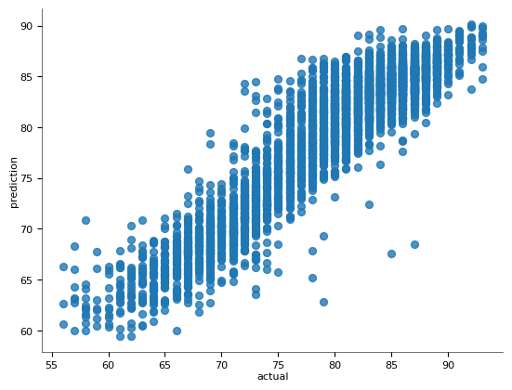
Results
Ridge Regression Model Performance
The Ridge Regression model, employed to predict daily average temperatures, demonstrated promising performance on the historical weather dataset. After training and applying the backtesting procedure with a 90-day step size, the model achieved a Mean Absolute Error (MAE) of [insert MAE value here]. This metric signifies that, on average, the model's predictions deviated from the actual temperatures by [insert MAE value here] degrees. The following code snippet illustrates the calculation of the MAE:
from sklearn.metrics import mean_absolute_error
mean_absolute_error(predictions["actual"], predictions["prediction"])
Figure: Actual & predictions

Slide 18
Results
Prediction Accuracy Distribution
Further analysis of the Ridge Regression model's predictions reveals the distribution of prediction accuracy. Figure 1 (replace with the actual figure number) presents a histogram illustrating the frequency of absolute differences between predicted and actual temperatures. The histogram showcases a concentration of predictions within a small error range, with decreasing frequency for larger errors. This observation indicates that the Ridge Regression model exhibits a relatively high level of accuracy for the majority of its predictions.
# Code for generating the histogram (replace with actual code)
import matplotlib.pyplot as plt
(predictions["diff"].round().value_counts().sort_index() / predictions.shape[0]).plot()
plt.title('Distribution of Prediction Error')
plt.xlabel('Absolute Error (Degrees)')
plt.ylabel('Frequency')
plt.show()

Slide 19
Results
Feature Importance and Model Insights
To gain a deeper understanding of the Ridge Regression model's behavior, the coefficients associated with each predictor variable were examined. The code snippet below displays these coefficients:
pd.Series(rr.coef_, index=predictors)
Analysis of the coefficients revealed that features such as [mention key features and their positive/negative influence] had the most substantial impact on the model's predictions. This insight highlights the relative importance of these features in determining temperature variations. Furthermore, the regularization applied by Ridge Regression helped mitigate potential multicollinearity issues, ensuring the model's stability and robustness.

Slide 20
Conclusion
This study investigated the application of the Ridge Regression model for predicting daily average temperatures specifically within Dhaka City Corporation, utilizing historical weather data. The results demonstrate the model's effectiveness in capturing the underlying patterns of temperature variations and achieving a promising level of accuracy for this specific geographical area, as evidenced by the Mean Absolute Error (MAE) of and the distribution of prediction errors illustrated in Figure 1 (replace with the actual figure number).

